Slide 1
SCC204 Software Design
State Diagram
Zhang Jinyu
zjy@bjtu.edu.cn

Slide 2
Your Tasks
Analyse the requirements and develop:
Statechart
Class diagram (State pattern)

Slide 3
A Case Study: Microwave Oven
To start cooking, a user enters the amount of time by pressing Digit and puts food on the tray
The user closes the door and presses Start
If the user opens the door while cooking, the oven is suspended.
The oven resumes cooking, when the door is closed
To cancel cooking, press Stop
You CAN have a weight sensor!

Slide 4
A Use Case: Cook Food
Use Case Model for Microwave Oven
Use case name: Cook Food
Summary: User puts food in oven, and microwave oven cooks food.
Primary Actor: User
Secondary Actor: None
Precondition: Microwave oven is idle.
Description:
1. User opens the door, puts food in the oven, and closes the door.
2. User presses the Digit button to set the cooking time.
3. User presses the Start button.
4. System starts cooking the food.
5. System continually displays the remaining cooking time.
6. The timer elapses and notifies the system.
7. System stops cooking the food and displays the end message.
8. User opens the door, removes food from the oven, and closes the door.
9. System clears the display.
Alternatives:
1.a: User presses Start when the door is open. System does not start cooking.
6.a: User opens the door. System is suspended.
6.b: User closes the door. System is resumed. Go to 5.
Exceptions:
5.a: User press the Stop button. System is idle.
Postcondition: Microwave oven has cooked the food.
heavy day:正常流程 （考试有）
green filled:在新系统开发

Slide 5
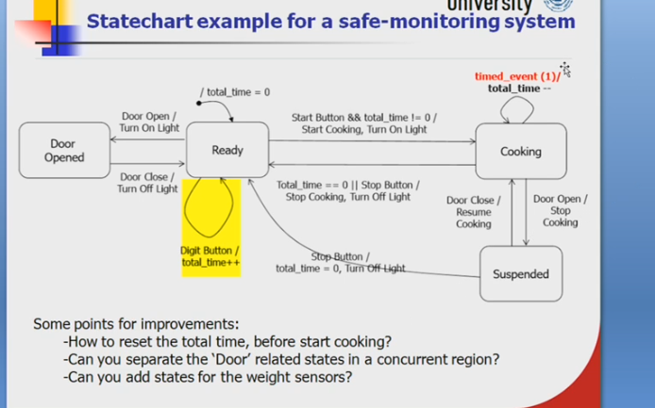

Slide 6
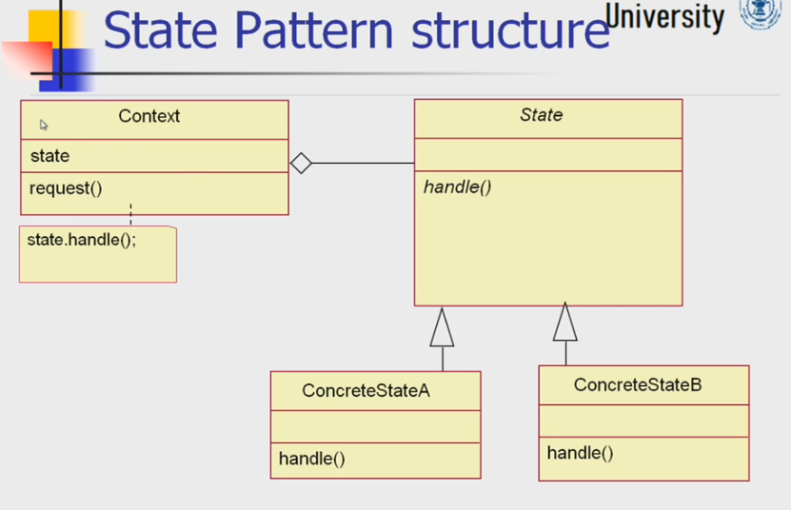
Question？

